Slide 1

SceneIt: A Modern Movie Discovery Application
This presentation details the architecture, features, and technical achievements of our modern movie discovery application.
Group No. 01
Section - 05
Group Members:
NAME
ID
KAZI ABID SHAHORIAR
2211967042
SUDIPTO ROY
2222756042

Slide 2
Unveiling SceneIt
SceneIt is a modern, full-stack movie discovery application designed to provide users with a seamless and engaging experience for exploring the world of cinema. Users can search, browse, save movies to a personal watchlist, view detailed information, rate films, and manage their profiles.
Built with a robust React Native (Expo) mobile frontend and a high-performance Node.js/Express backend with MongoDB, SceneIt delivers a responsive, cross-platform experience optimized for both mobile and web.

Slide 3
Core Features at a Glance
1
2
Movie Search & Details
Personal Watchlist
Real-time search across thousands of movies powered by the TMDB API, with comprehensive details including cast, synopsis, ratings, and reviews.
Users can effortlessly add movies to a personal watchlist for easy access and future viewing.
3
4
User Ratings & Profiles
Cross-Platform & Optimized
An intuitive 5-star rating system allows users to express their feedback, while secure authentication and profile management enable personalized experiences with unique Dicebear avatars.
Runs seamlessly on iOS, Android, and Web, with performance optimizations like image loading, infinite scroll, and debounced search for a smooth user experience.

Slide 4
Architectural Blueprint
Mobile Frontend (React Native - Expo)
Backend API Server (Node.js - Express)
Framework: React Native (Expo) for rapid development and cross-platform deployment.
Framework: Node.js with Express for a fast and scalable API.
Database: MongoDB with Mongoose for flexible NoSQL data storage.
Routing: Expo Router for intuitive, file-based navigation.
Styling: NativeWind (Tailwind CSS) for a modern, responsive, dark-themed UI.
Authentication: JWT for secure API access and bcrypt for robust password hashing.
State Management: React Context, Zustand, and AsyncStorage for efficient data handling.
Routes: Dedicated routes for authentication (/auth/register, /auth/login) and user profile management (/user/profile).
Components: Modular design with reusable components like MovieCard, SaveButton, and StarRating.
Third-Party Integration: Dicebear API for unique user avatars.
Configuration: dotenv for secure environment variable management.
API Integration: Seamless connection to TMDB for movie data and our custom backend for authentication and user profiles.

Slide 5






Technology Stack
React Native & Expo
Node.js & Express
Powering the cross-platform mobile experience with rapid development cycles.
Robust backend for API services, handling requests and data processing.
MongoDB & Mongoose
JWT & bcryptjs
Flexible NoSQL database for efficient data storage and retrieval.
Ensuring secure authentication and robust password hashing.
NativeWind
TMDB API
Utility-first CSS framework for rapid and consistent UI development.
Accessing a vast database of movie information.

Slide 6

Authentication & Data Protection
SceneIt prioritizes user data security and privacy. We implement a multi-layered approach to protect sensitive information, from user authentication to secure data storage.
JWT-based Authentication: Secure API access is facilitated through JSON Web Tokens, ensuring that only authenticated users can access protected resources. Tokens are securely stored on the device using AsyncStorage.
Password Hashing: User passwords are never stored in plain text. We utilize bcrypt for robust password hashing, adding multiple layers of security to prevent unauthorized access.
Unique User Avatars: Dicebear avatars provide unique, randomly generated profile images for users upon registration, enhancing personalization without requiring photo uploads.

Slide 7
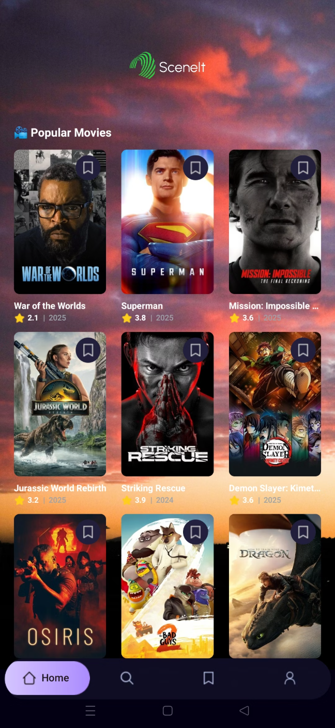
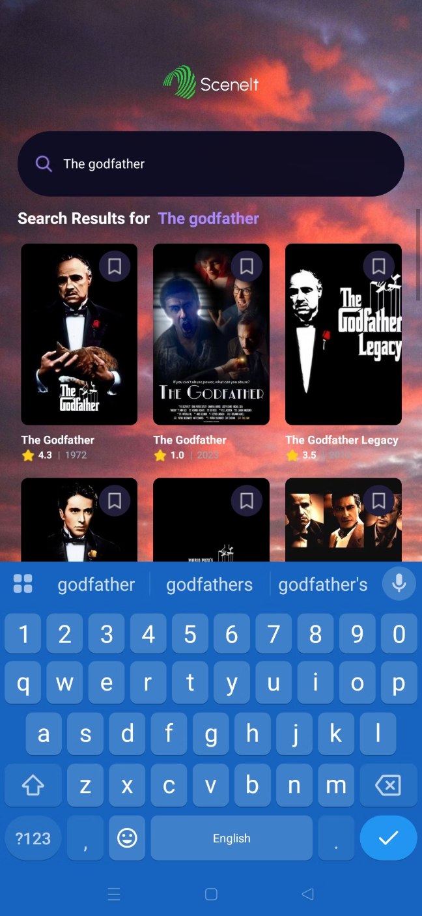
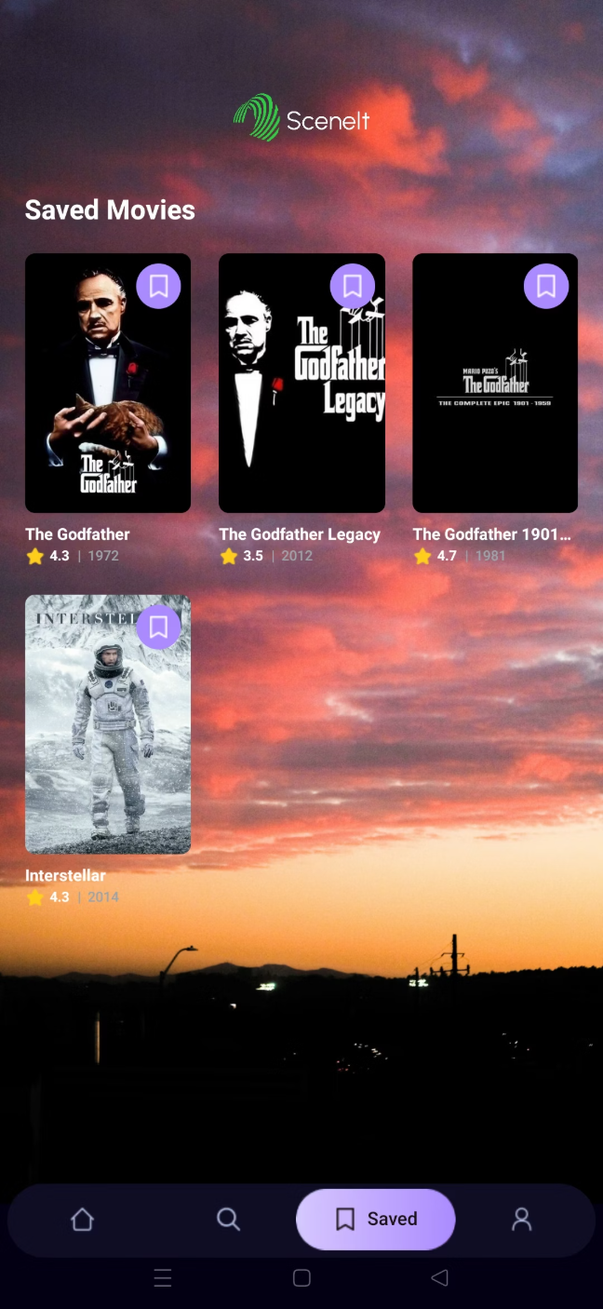
Project UI
Home
Search
Saved (watchlist)

Slide 8
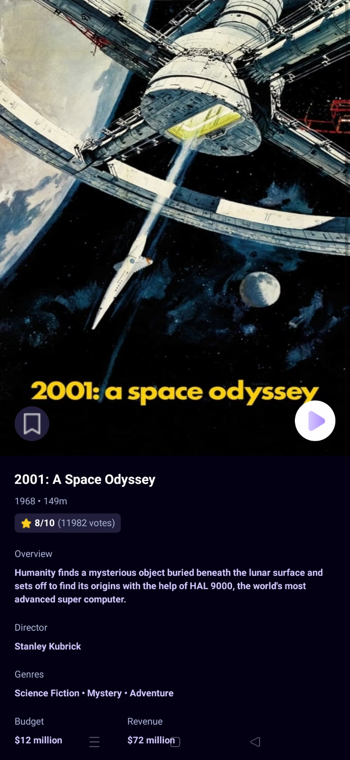
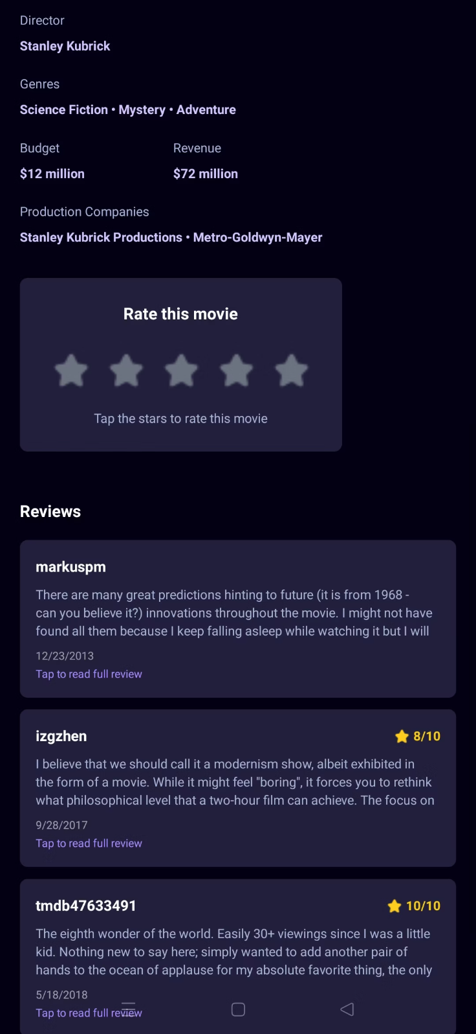
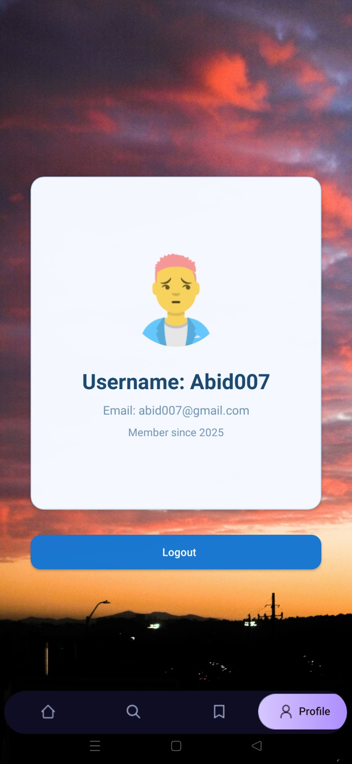
Movie Details
Rating and Review
Profile

Slide 9




UI/UX Highlights
Dark Theme & Gradients
Responsive Layouts
Animations & Scrolling
A sleek, modern dark theme with subtle gradients and accent colors for a premium visual experience.
Optimized for all device sizes, ensuring a consistent and appealing interface on phones, tablets, and web browsers.
Animated transitions and smooth scrolling enhance user interaction and visual fluidity.
Optimization (React memo)
higher-order component (HOC) in React that optimizes functional components by preventing unnecessary re-renders. It works by "memoizing" or caching the rendered output of a component based on its props.

Slide 10
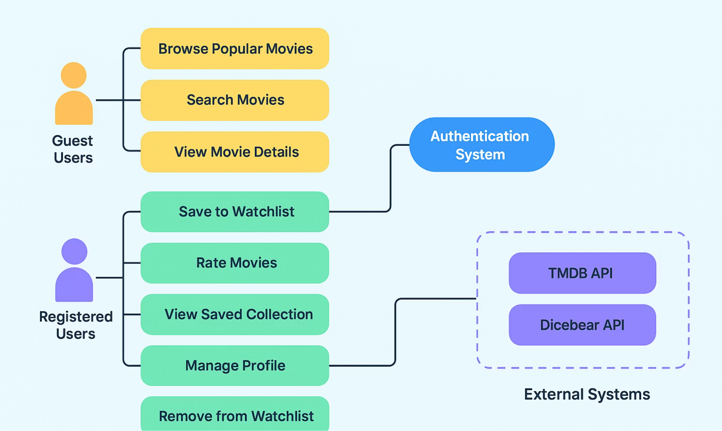
Use Case Diagram

Slide 11
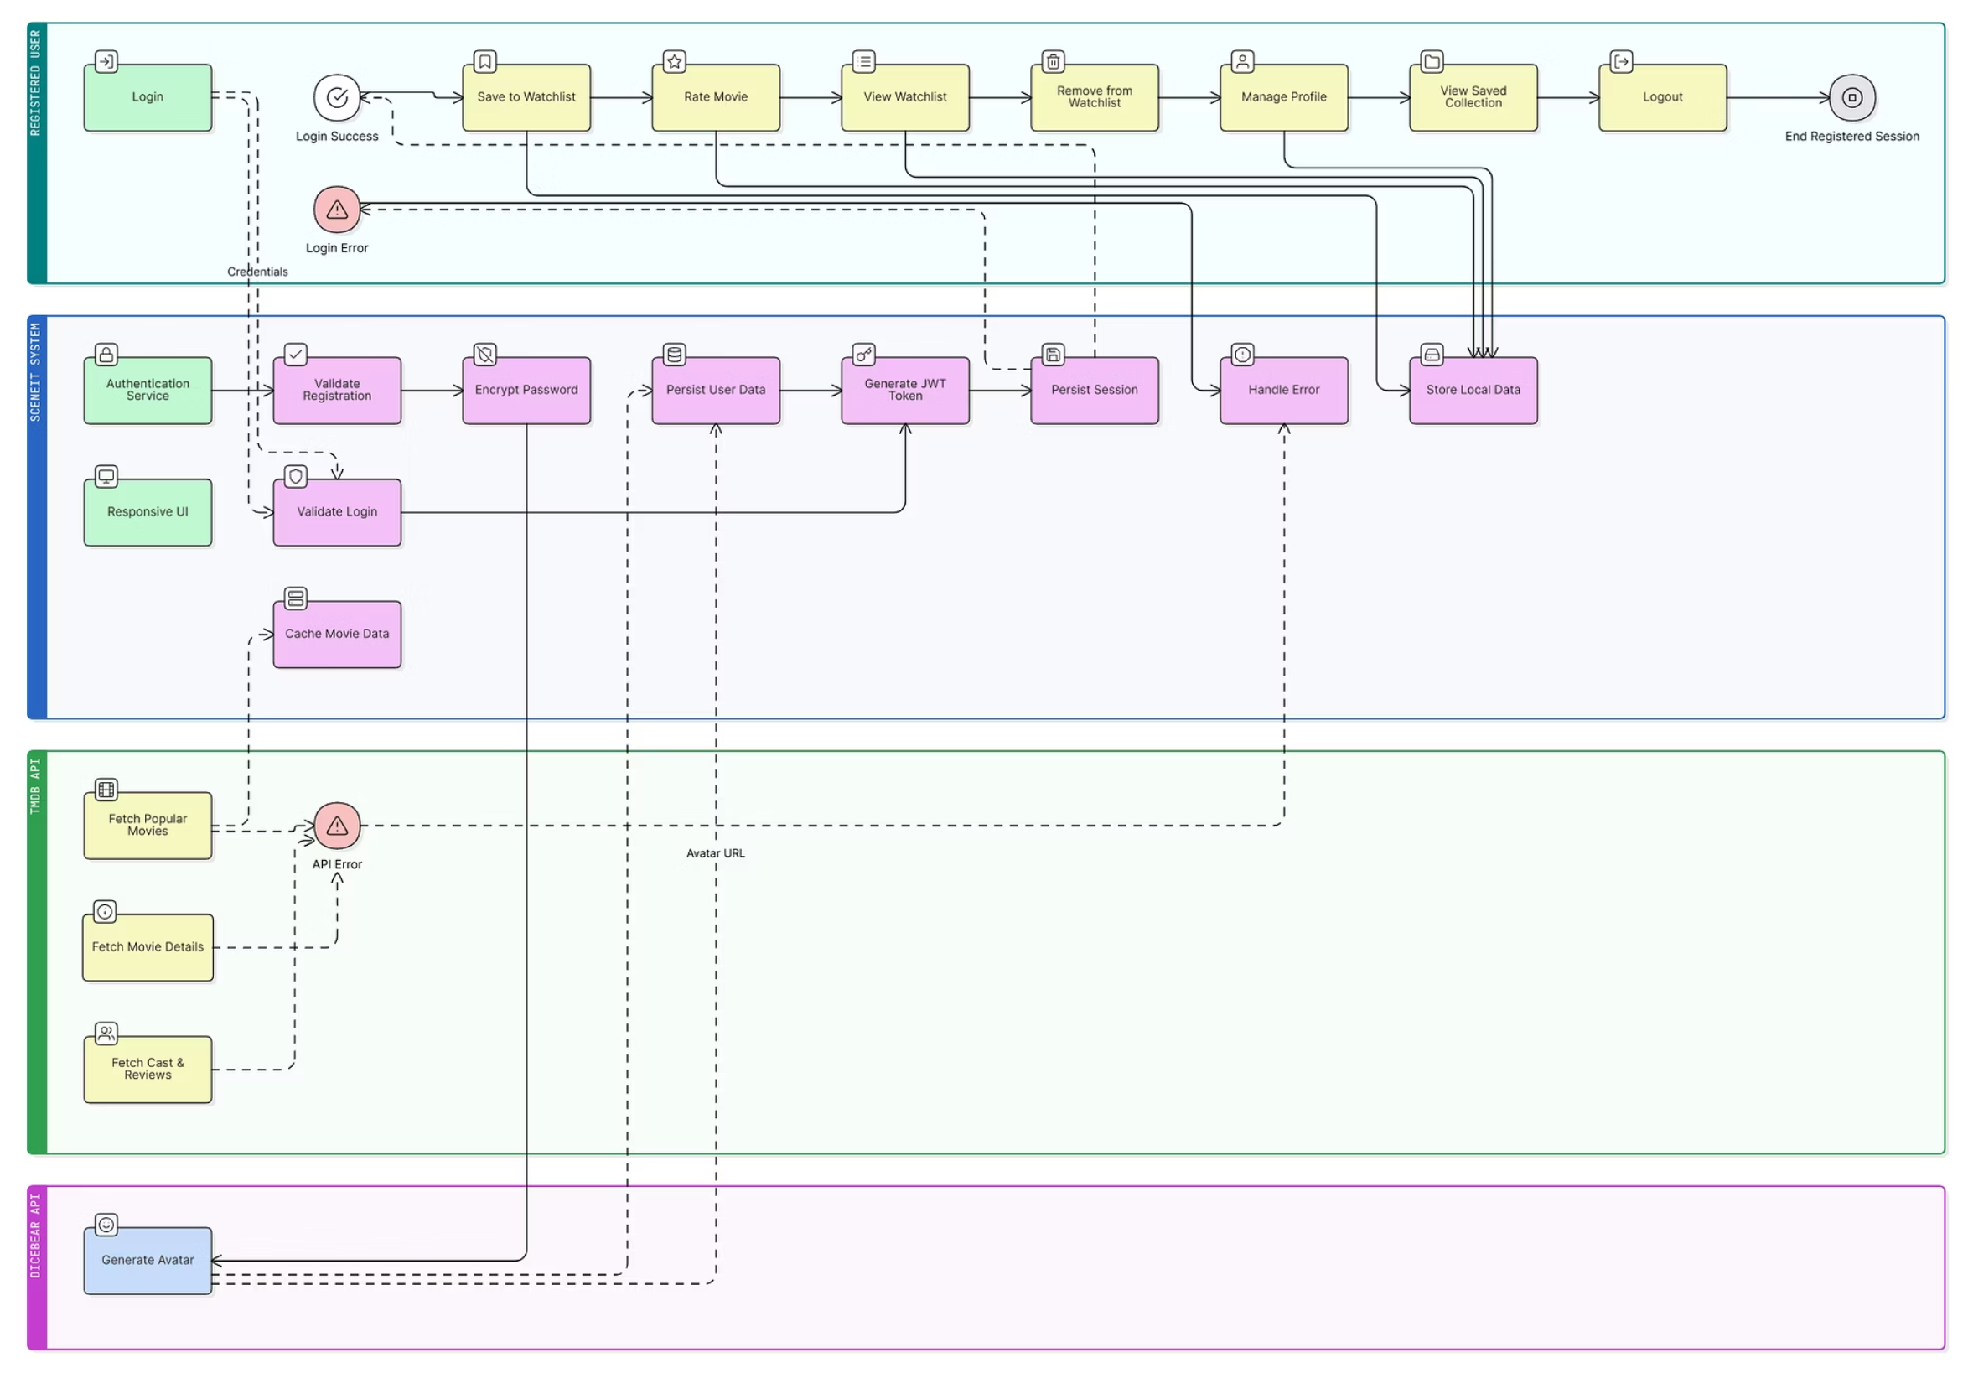
Cross-Functional Flowchart

Slide 12





Future Enhancements
The RAG Chatbot Answers Your Top Film Questions
Integrating RAG Chatbot here to provide expert insights and recommendations on the greatest films of all time.
Social Features & Sharing
Integrating social functionalities such as sharing movies with friends, following other users, and viewing their activity.
Personalized Push Notifications
Sending push notifications for new releases, personalized recommendations, and updates on saved movies.
Advanced Recommendations
Leveraging machine learning for more sophisticated movie recommendation algorithms based on user preferences and viewing history.

Slide 13
Thank You.

